Slide 1
Programming and Java

Slide 2
Key Topics
Programming
Java
Getting Started

Slide 3
Programming

Slide 4
Basic Terms
Programming: writing source code that gives the computer instructions
Source code: code that we write that makes up a program
Program: a group of instructions bundled together to perform one main task

Slide 5
What is an Application?
An application is a computer program with an interface, enabling people to use the computer as a tool to accomplish a specific task – from dictonary.com
Interface: provides a means of interaction between two things. Two types:
GUI: graphical user interface
uses color, buttons, graphics for the user to use to interact with the program
CLI: command-line interface
uses mostly text-based commands for the user to use to interact with the program

Slide 6
Process from Source Code to Execution
Machine code
Also known as binary
1s and 0s are the only values
Lowest level language that is what the computer understands
Assembly: lowest level programming language
Taken in by the CPU and assembled into binary
Very simple instructions and a lot of them
Specific to the type of CPU
High Level programming language: easier for the developer to read and write
Compiled: entire source code is translated from one language to another language using a compiler
this is called ahead of time compilation
Interpreted: source code is translated and executed line by line by an interpreter
this is called just in time compilation
Usually interpreted languages are meant to run in a specific environment, like the browser or a shell

Slide 7

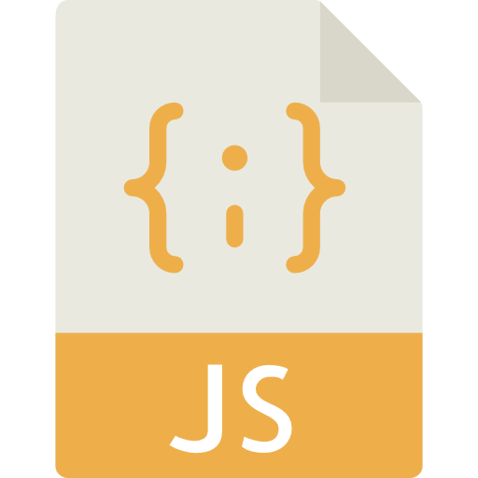

Process from Source Code to Execution
Compiler
Interpreter
High Level Language
Low Level Language
Notes:
Computer with Person icon from Monkik at flaticon.com JS Code icon from Smashicons at flaticon.com
Computer with Binary icon from Freepik at flaticon.com

Slide 8
Programs and Memory
There are two ways a computer can store information:
Short-term memory:
Used for active programs and system processes
Faster access
Temporary (computer needs to be on)
RAM, CPU cache
Long-term memory:
Used for storage permanent data
HDD, SSD, flash drives, CDs, etc
When a program runs, any data it needs to create and use are stored temporarily, in RAM, until it stops executing.

Slide 9
Java

Slide 10
What is Java?
Java is a high-level, general purpose, objected oriented programming language:
High level:
No memory management in Java
Designed to be easier to use than lower level languages
General purpose:
Capable of creating a variety of programs
Object Oriented:
allows you to easily create modular, reusable code

Slide 11
How Does Java work?
JDK: The Java Development Kit is required to develop Java applications
this is what you installed when you “installed Java”
It contains a compiler and the JRE
The compiler converts Java source code into bytecode
JRE: The Java Runtime Environment is required to run Java applications
it contains the Java API
It contains the JVM
JVM: The Java Virtual Machine is an interpreter that executes Java programs
It takes in bytecode created by the compiler and translates and executes it into machine code

Slide 12
JDK, JRE, JVM Visualized
Source Code:
.java
javac command
JDK: Java Development Kit
JRE: Java Runtime Environment
Bytecode:
.class
JVM: Java Virtual Machine
JiT compilation
What the OS, operating system,
can actually understand

Slide 13
Getting Started with Java

Slide 14
Java is Strict with Syntax
When compiling a program, the compiler will look for common problems, typos, or other mistakes in your code.
Missing semicolons
“Symbol not found”: a typo in a keyword, or a valid class couldn’t be found by the compiler
Code that could generate problems (exceptions) is not handled safely
The compiler will tell you the line on which the error occurs, or near it.
An IDE will usually catch these errors before compiling and warn you.

Slide 15

Object Oriented Programming
Object Oriented Programming: writing code in such a manner as to model real-world objects
Objects have state and behavior
State: properties or characteristics
Behavior: an action the object can do
state
behavior
on or off
color
name
walk
grab things
light up

Slide 16
OOP Project Structure
Java code is written as modules, packages, and classes instead of a list of instructions
Modules are groupings of packages
Packages are groupings of classes
Classes are blueprints for objects
Code is written within classes
One class is used to start program execution
This modular approach to organizing our project makes it easier to test, maintain, and refactor.
APPLICATION
modules
classes
packages

Slide 17
Package Structure
Packages become nested folders used to organize sub-packages, classes, or interfaces
com.revature.example → /com/revature/examples
Package declarations are used to specify which package a class is in
They must be the first statement in your class
if you don’t put a source file in a package, it goes into the default package
package syntax
folder path
package com.Revature.example;
public class MyClass{
// other code here
}
package declaration

Slide 18
Classes
We write our code in classes
Classes are blueprints used to instantiate objects
Classes have state (variables) and behavior (methods) that are given to each object created from the class
Behaviors and states are shared across all instances of a class, but the values of variables may be different and can change
Example) Two people both have the name variable but the value for one person’s name is Bob, while the value of the other person’s name is Francis

Slide 19
Anatomy of a Class
Access Modifier class Class Name {
// variables and methods
}
Ex:
public class Dog {
// variables and methods
}

Slide 20
Executable Classes
A class with a specifically-declared main() method is executable
The JVM can invoke that method without creating an instance of the class first
This is the starting point of your application
An application usually only has one executable class
public class HelloWorld { public static void main(String[] args) { System.out.println(“Hello World!”); } }
an example of an executable class

Slide 21
Methods
A method is a block of code that runs when you call it
Can take in input
Can return a value
aka, a function!
Java wants to know exactly what kind of method it is:
The type of data it takes in, if any
What it returns, if anything
If it belongs to the class*
Its level of access*
* Don’t worry about these last two things, we’ll go over them later!

Slide 22
Anatomy of a Method - Java
Access Mod Non-Access Mod Return Type Name (Parameters) {}
Ex:
public static void main (String[] args) {
system.out.println(“Hello World”);
}
protected float add (float num1, float num2, String str) {
return num1 + num2;
}

Slide 23
The Javadoc
The Javadoc is the documentation for the Java language.
https://docs.oracle.com/en/java/javase/11/docs/api/index.html
The Javadoc describes every class and method in the Java API.

Slide 24
Recall
How does programming work?
What is Java?
What are the steps from writing Java code to running on the computer?
What are compile time errors?
What is Object Oriented Programming?
What are packages, classes, and methods?

Slide 25
Questions

